Slide 1
Career Research Project
Alison Ritz

Slide 2
Equine (Horse) Trainer
Job Description and why I want to do this….
Horse trainers, also called equine trainers, work with horses to prepare them for riders, races, trail work and/or horse shows. They help horses adapt to wearing saddles and bridles, teach vital riding commands and work with the animals to correct behavioral issues related to abuse or other trauma. Horse trainers are required to have expert riding skills and a thorough knowledge of horse management. Patience and a love of animals can also be extremely beneficial.
I would like to go into this career because I have always had a passion for working with horses. I have also been riding for as long as I can remember and I was in 4H for 2 years.
Career Cluster-Human Service/Education and Training
I also love this job because I could stay where I sm or move anywhere close to rural areas.

Slide 3
Characteristics
Values- Patience, and understanding
Tasks and responsibilities- Horse trainers use their voices and plenty of physical contact. Most trainers also observe a horse's nutrition, feeding habits and health, which may be discussed with veterinarians and horse nutritionists if the trainer suspects the animal is ill. Because horses are frightened easily, horse trainers work on ways to counteract that tendency. Throughout the training period, horse trainers may be thrown off the horse, stomped on, kicked or bitten. In addition to training horses, horse trainers also teach people how to interact with horses properly. Horse trainers teach jockeys how to direct and manage racehorses. They also teach horse owners how to care for and handle horses.Cleaning horse stables and grooming are sometimes the duties of horse trainers. If these duties are delegated to other equine workers, the horse trainer supervises the chores. Horse trainers also acclimate horses to walking onto horse trailers to get them used to being relocated whenever necessary.
Work environment/hours-Horse trainers may be required to start work early and finish late. Even those that are self-employed may work long hours. The work may be in hot and not-so-clean conditions.
Salary- on average, horse trainers can expect to earn at least $835 per week ($43 399 per year), earnings will depend on the level of demand for their services, as well as their level of skill and experience. In many cases, the trainer will receive a percentage of the race winnings.
Education and training- Some horse trainers work as horse trainer apprentices where they perform stable chores, exercise horses, feed and groom horses and any other duties their mentors ask. Completing an equine studies program, which is offered by some colleges, is another way horse trainers learn required skills. Courses may include horsemanship, equine anatomy and physiology, facility management, equine behavior, animal ethics and welfare, equine nutrition and equine diseases.
Career outlook- According to the BLS, animal trainers earned an average yearly wage of $32,400 in May 2014. The top ten percent of these professionals took in $57,160 or more every year, while the bottom ten percent of workers made $17,650 or less annually.

Slide 4
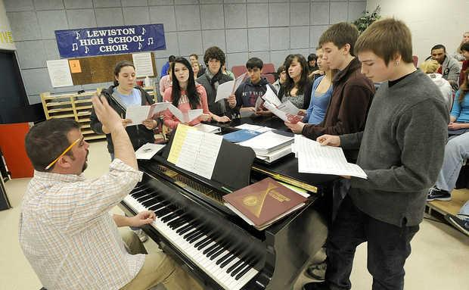
Choir teacher
Job Description and why I want to do this...
Choral directors provide oversight and administration for the vocal music programs of various organizations, such as schools or churches. Choral directors often compose and lead performances of vocal music. Those working in public school systems may also be required to hold music education classes.
Music has always been a huge part of my life. I have also always loved choir and singing so I believe I would be able to put my passion into teaching students about something that I appreciate so much.
Career Cluster- Education and Training
I can live anywhere I wanted.

Slide 5
Characteristics
Values- Friendly, patient, and understanding
Tasks and responsibilities- Responsible for teaching people instrumental techniques, scales, sight reading and music theory, the majority of music teachers help pupils to prepare for music examinations, auditions and live performances. Some might even teach people about recording software, such as Pro Tools and Logic. They may also be responsible for keeping parents up to date on their children’s progress.
Work hours-Private music teachers tend to give the majority of lessons in the evenings and at weekends in order to fit around their pupils’ work and school schedules. Therefore, many work part-time. Music teachers are usually required to travel around from school to school and from house to house on a daily basis.
Education and training-Some teachers earn their bachelor's degree in music and go on to earn their graduate certificate or master's degree in education. They can also earn their Bachelor of Music degree in music education or take a minor in secondary education with a major in music. Graduates of a doctorate degree in music are prepared for teaching music at the university level.
Salary and benefits-Music Teachers in the K-12 system are usually salaried employees. Teachers who give individual lessons are paid by the students themselves, often receiving payment for a month at a time. Lesson times are generally 30 minutes to an hour, with the average hourly wage for Private Teachers around $50/hour.
Career outlook- Teachers' pay can vary by the academic level taught. According to the BLS, elementary school teachers earned a median salary of $53,400 in 2012, while middle school teachers earned $53,430, and high school teachers earned $55,050. The BLS reported that post-secondary school music teachers earned median pay of $62,160 that same year.

Slide 6
Criminal Lawyer
Job Description and why I want to do this...
Criminal lawyers have the same basic duties as other lawyers. First, they advise their clients of their legal rights and responsibilities, as well as any potential problems. Second, they represent their clients before the courts. Third, they research rules, regulations, and previous cases. Finally, they prepare legal documents. In each case, lawyers interpret the law and apply it to specific situations. They also deal with cases that involve crimes, like murder, robbery, assault, and fraud.
I believe I could make a good lawyer because I can always get people to tell the truth and I am very good at persuading people.
Career Cluster- Law and Public Safety
I could live in any big city.

Slide 7
Characteristics
Values- patience, determination, honesty, and understanding
Tasks and responsibilities- Criminal defense attorneys have a duty to avoid conflicts of interests when representing their clients. For example, if several accountants are accused of criminal fraud their defenses may include shifting blame to one another. Attorneys cannot implicate one client to help another. Attorneys must also ensure that past clients do not create conflicts in current cases. For instance, an attorney may not be able to adequately attack a witness if the two of them previously shared an attorney-client relationship.
Work hours- Criminal defense lawyers typically work at least 40 hours a week, but longer hours are common. Additionally, work hours may be irregular because evenings and weekends may be required by clients or law firms.
Education and training- A criminal lawyer must hold a juris doctorate and an attorney’s license in order to practice criminal law. Experience in criminal law is advisable before obtaining a position as a criminal lawyer. However, significant clinical experience may be equated with some criminal law experience for a recent graduate. Or, participation in internships, volunteer positions or part-time jobs with public defenders and prosecutor offices can be the necessary work experience required.
Salary and benefits-The average salary of a criminal lawyer is $78,500. However, the salary can range from $45,000 to $130,000. Interestingly, private criminal lawyers make the lowest earnings among lawyers. Experience and rising to the top of the career ladder however increases a criminal lawyer’s pay scale.
Career outlook- Traditionally, a criminal lawyer begins as a junior associate at a law firm, a prosecutor, or a public defender. Next, a criminal lawyer can advance to senior associate at a law firm or as a solo practitioner who is essentially self-employed. The ultimate aspiration for a criminal lawyer may be as a partner in a law firm.

